Slide 1
Microsoft Teams for Education Overview
Creating Team classes with basic setup for a course and scheduling of online instruction.

Slide 2
Office 365 Application Menu
After logging into the Office 365 web application you are presented with office web applications. Single-click an application to launch it.
Office 365 applications are highly integrated to share information between them and to simplify collaboration.
Clickable link above!!
Teams is the application that we will be using for class. You can download this as an app on your devices or use it within a web browser.

Slide 3
This is Microsoft Teams
Log on using your user name and password. I suggest downloading the desktop app.
When you log on,
you should see your
teams listed exactly
like your schedule shows
your classes.

Slide 4
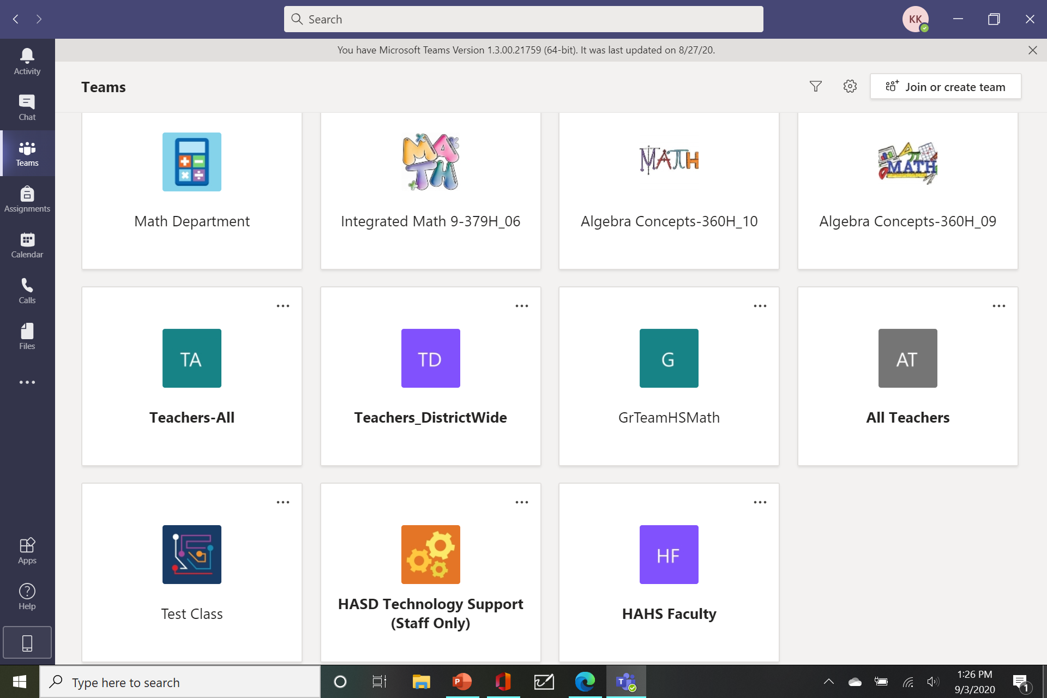
This is how mine looks. You will be able to see each of your classes here.

Slide 5
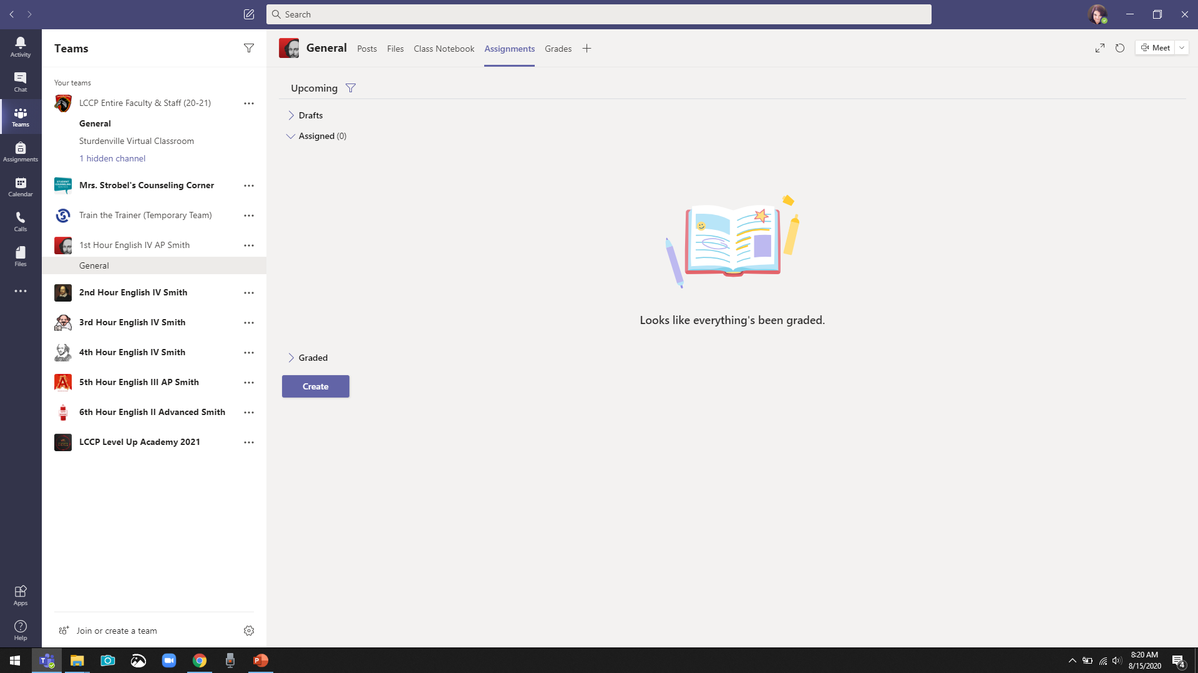
You will find our class meetings and assignments under the general tab within the course. This is also where you will find links to previous class recordings and assignments in case you have missed a class.
You will submit your assignments here within the class team.

Slide 6
We will meet every
School day at the
same time.

Slide 7
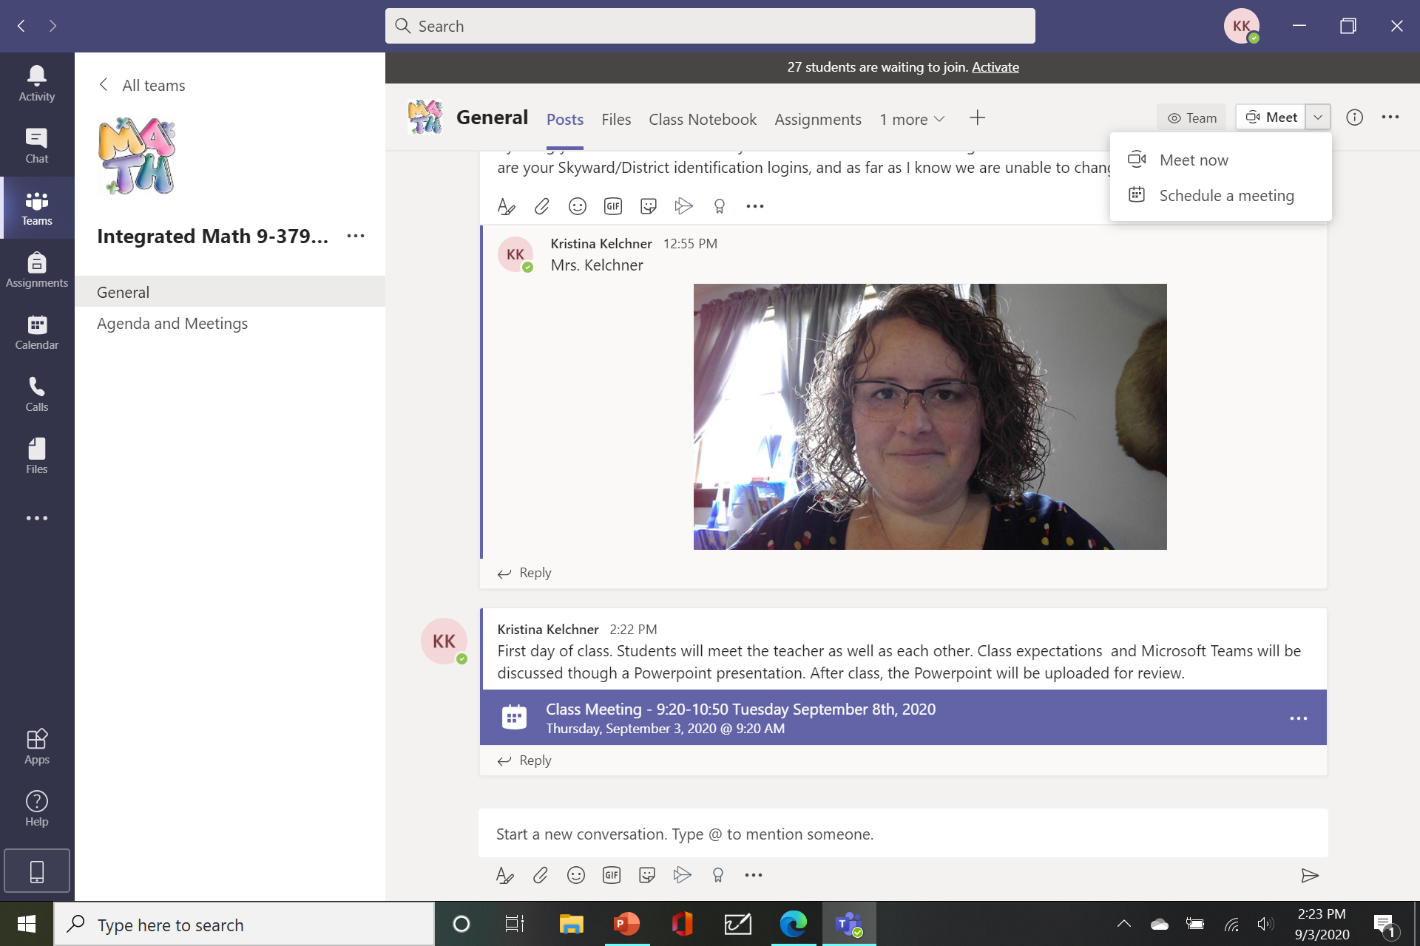
Click in one of the two
places. Yours will say Join.
Be on time with your video
on.

Slide 8
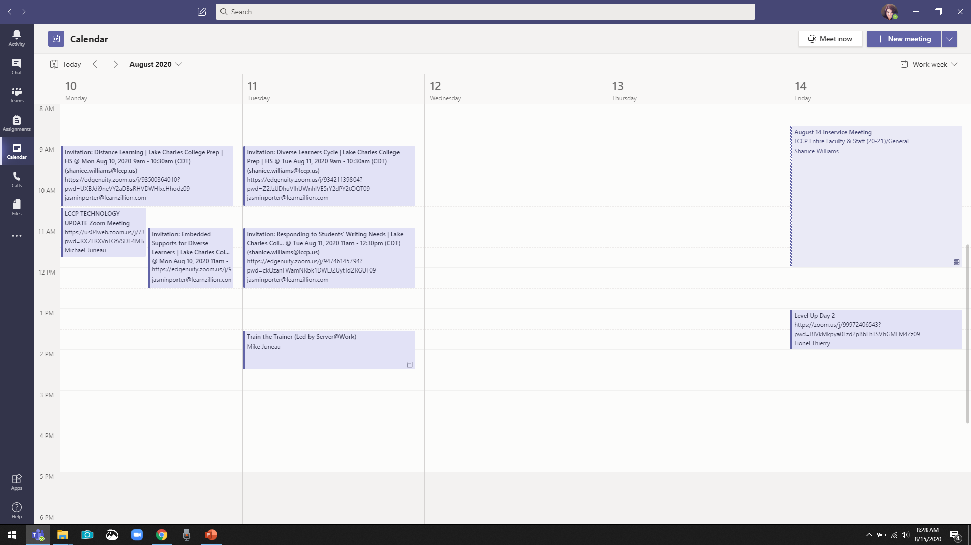
You can also
Join from
here.

Slide 9
Check Your Devices Setup
Select Devices before every call or meeting to verify Speaker, Microsoft, and Camera settings. All devices must be connected prior to starting Microsoft Teams.
*Earbuds/headphones may be helpful to keep other distractions around you to a minimum.
*Although most devices already have them imbedded, a microphone may not be necessary.
*Microphones should be turned off while lessons are taking place.

Slide 10
You can see all your
assignments in one place.

Slide 11
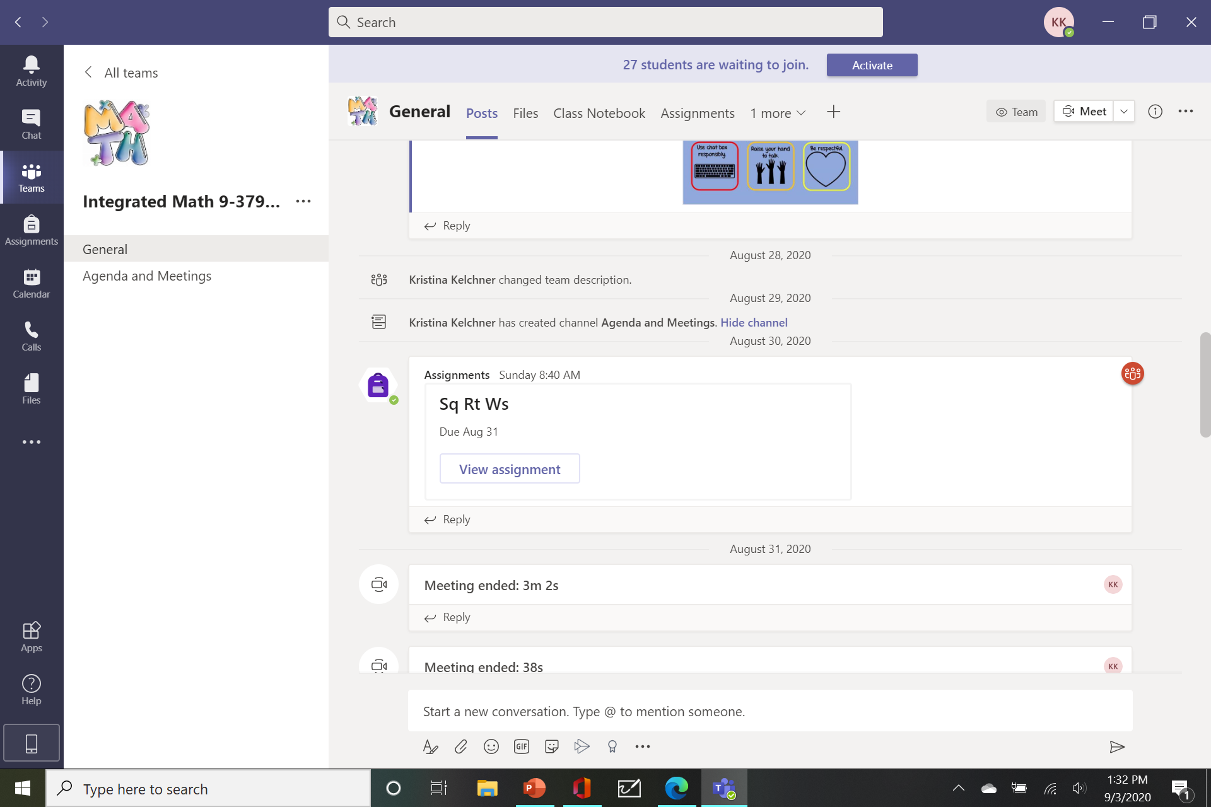
You will find our class meetings and assignments under the general tab within the course. This is also where you will find links to previous class recordings and assignments in case you have missed a class.
You will submit your assignments here within the class team. If necessary they can be emailed.

Slide 12
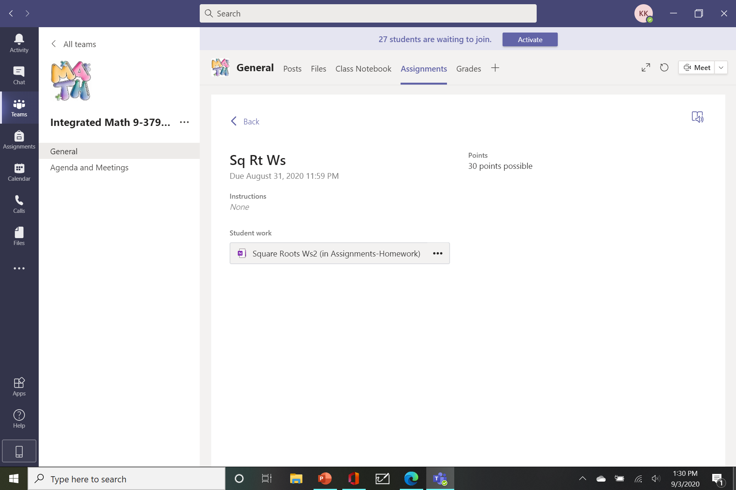
You can also find your assignments under the assignment tab. Click on the assignment to open the worksheet. You are expected to show your work. If necessary, copy the problems onto a piece of paper and show your work. You can also write on the worksheet if you are using a phone/tablet/touch screen and save your work that way.

Slide 13
Pay attention to due dates.
If your assignments are not on time, then the window will lock.
You will be expected to complete an assignment each day that class is held.
Completing your assignment is how attendance will be taken. If you do not finish your assignment prior to the next time we meet as a class, you will be marked absent for the day of the incomplete assignment.
If you know that you will be absent, are sick, have unexpected issues please contact me so we can make accommodations.

Slide 14
I need to address cheating.
If you do not do your own work, you will receive a ZERO
Non-negotiable.
**I encourage you to work together whenever possible, but you must complete and turn in your own assignment.

Slide 15
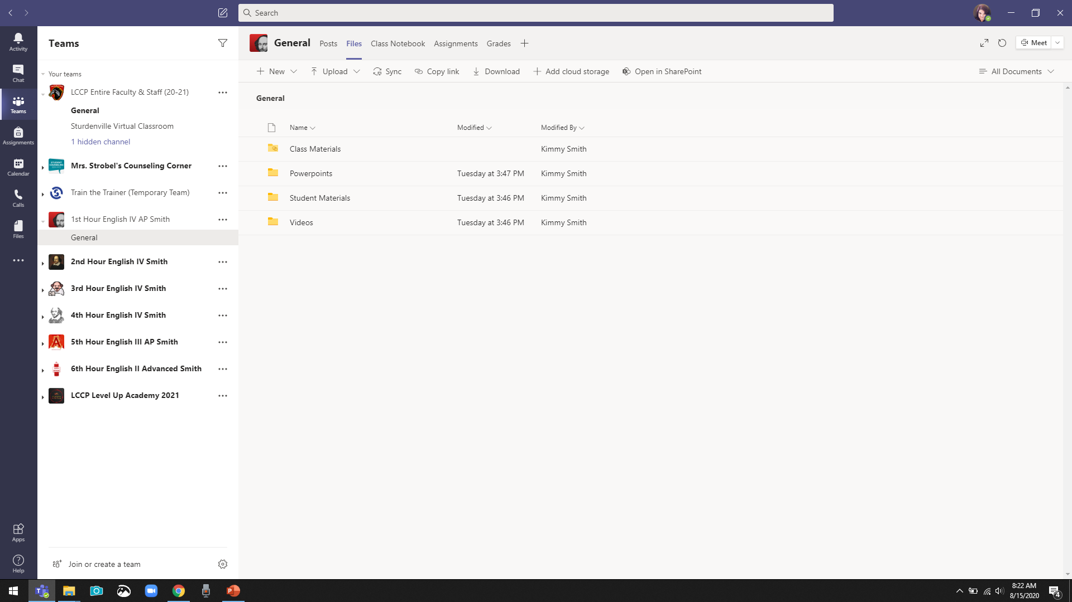
I will include helpful videos and class hound outs under the files tab.

Slide 16
If you have any suggestions after viewing and participating within your other courses, please give me tips and tricks. We are all new to this!

Slide 17
Any questions?

Slide 18
You can contact me any day
in three ways:
kelchnerk@hasdk12.org
Chat or call through
Teams
-my office hours are 8:30-9:15

Slide 19
Please explore our class team and see if there is anything you
have questions about.

